Slide 1
Exceptions
CAD Advanced Python Week 4

Slide 2
http://bit.ly/2oRXv5n

Slide 3
Intro
What happens when we have an error?
Enter a number: “hello”
ERROR: “hello” is not an int

Slide 4
Exception Syntax
try:
<body>
except <ExceptionType1>:
<handler1>
except <ExceptionType2>:
<handler2>
except <ExceptionType3>:
<handler3>
except:
<handlerExcept>
else:
<process_else>
finally:
<process_finally>
try:
<body>
except <ExceptionType>:
<handler>

Slide 5
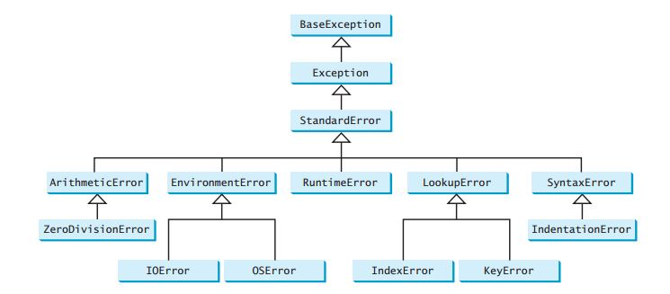
Exception Types

Slide 6
Raising an error
ex = RunTimeError(“This is an invalid input”)
raise ex
or we can also write
raise RunTimeError(“This is an invalid input”)

Slide 7
Exercise #1
Ask the user to enter a number and return the square of that number.
If the user does not enter a number, handle the exception accordingly.

Slide 8
Exercise #2
Ask the user for two numbers separated by a comma, and return the first number divided by the second number as a float.
Hint - You can use this expression to ask for the two numbers:
Number1, number2 = eval(input(<promt>))

Slide 9
Exercise #3
Write a program that asks the user for their name. If the user enters something other than a string, handle the exception accordingly. If the user enters a string without capitalizing the first letter, raise a SyntaxError.

